Slide 1



Payment Operated Automatic Paper Glass Fed Liquid Dispensing Machine
Prateek Shamprasad Pawar(2015BME002)
Prasad Shamrao Deshpande(2015BME016)
Bhagwan Panditrao Savandkar(2015BME017)
Niranjan Mohan Mane(2015BME032)
Manthan Nitin Dhisale(2015BME051)

Slide 2
Planning
Forecasting
Setting Premises
Setting Objectives

Slide 3

Forecasting
1. 70% of body is made of water

Slide 4

Forecasting
2. Usage of water not optimal, wastage

Slide 5
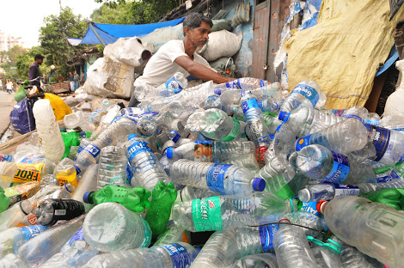
Forecasting
3. Government of Maharashtra bans non-biodegradable plastics, threat to packaged drinking water

Slide 6

Forecasting
4. Government launched Swatcha Jal Abhiyan

Slide 7
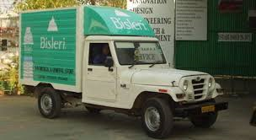
Forecasting
5. Current water distribution system, too many intermediates, waste of money and time

Slide 8


Forecasting
6. iOT based SCM is growing need of time and era of vending machines (self pay and purchase) is about to begin.

Slide 9
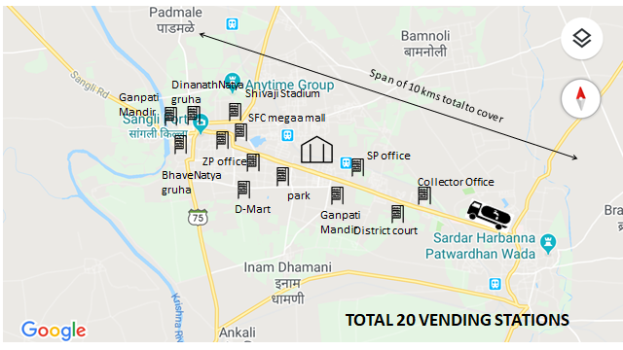
Setting Premises
Considering a rough model of our Sangli city and knowing stats about how much glasses of water will be required and how many visitors will be present, we came up with optimized setup.

Slide 10
Visions and objectives
To study different mechanical and electronic principles involved in the automation project.
To select appropriate sensors and actuators for constructing various mechanisms involved in the automation project. 3.
To manufacture a complete workable and commercial model by following aesthetic and ergonomic principles.
To implement Information of technology principles for exchange of information from the dispenser to the user.
To execute a proper algorithm-based program for Arduino controlled sensors and actuators for the intended application.
To include liquid monitoring features so as to control and provide proper dispensing of liquid to the customer.

Slide 11
Implementation
The implementation of the project plan is an important step because the accuracy of plan made for project is depending upon actual time taken for activity.

Slide 12
